Slide 1
Project title – IMDB Movie Analysis
Project Description :-
This project gives a brief idea about the movie analysis done by IMDB to give ratings based on different criteria.
A brief description of the case study and output required is given below :-
Clean the data
Find the movies with the highest profit?
Find IMDB Top 250
Find the best directors
Find popular genres
Find the critic-favorite and audience-favorite actors

Slide 2
Approach –
We have got datasets which contains tables that contain information regarding various fields related to movies to be rated by IMDB. We went through the dataset closely and then executed various queries to extract the required data from the table.
Tech/Tools used –
We used below mentioned tools to perform the analysis :-
PPT – To prepare a detailed report on the observations based on the data received.
EXCEL – Excel was used to perform entire analysis and the questions asked were answered.

Slide 3
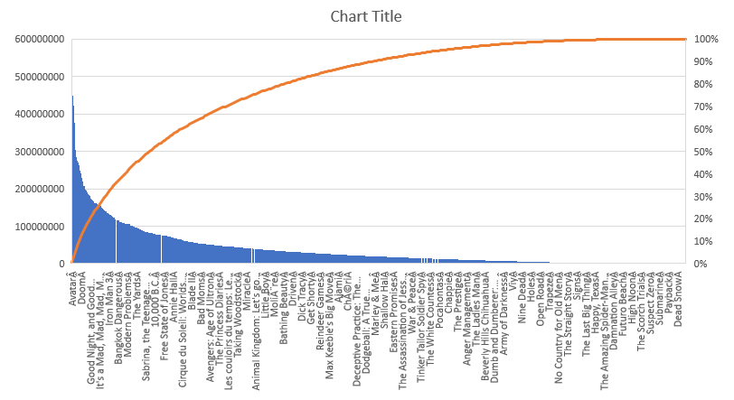
1.Clean the data
2.Find the movies with the highest profit?
Ans – Movie with the highest profit is Avatar.

Slide 4
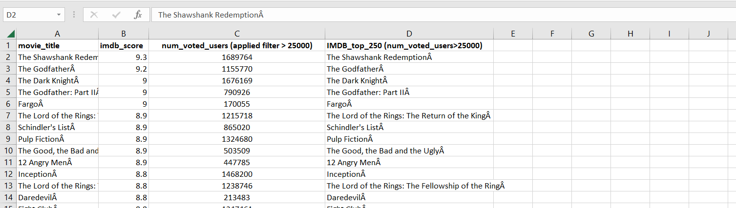
3. Find IMDB Top 250
Ans – First few of the 250 movies are present in screenshot. Rest entire data is available in excel sheet attached.

Slide 5
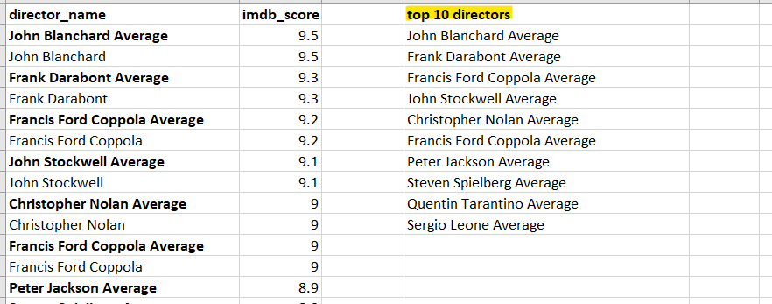
4. Find the best directors
The top 10 directors are as below :-

Slide 6
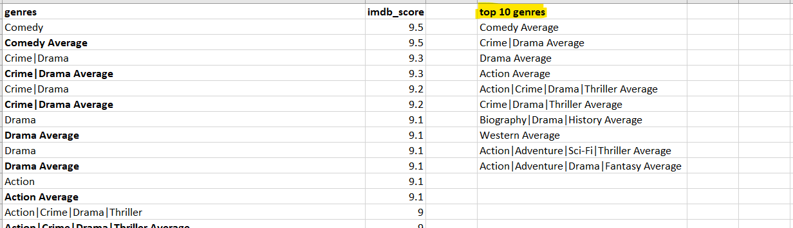
5. Find popular genres
The popular genres are :-

Slide 7
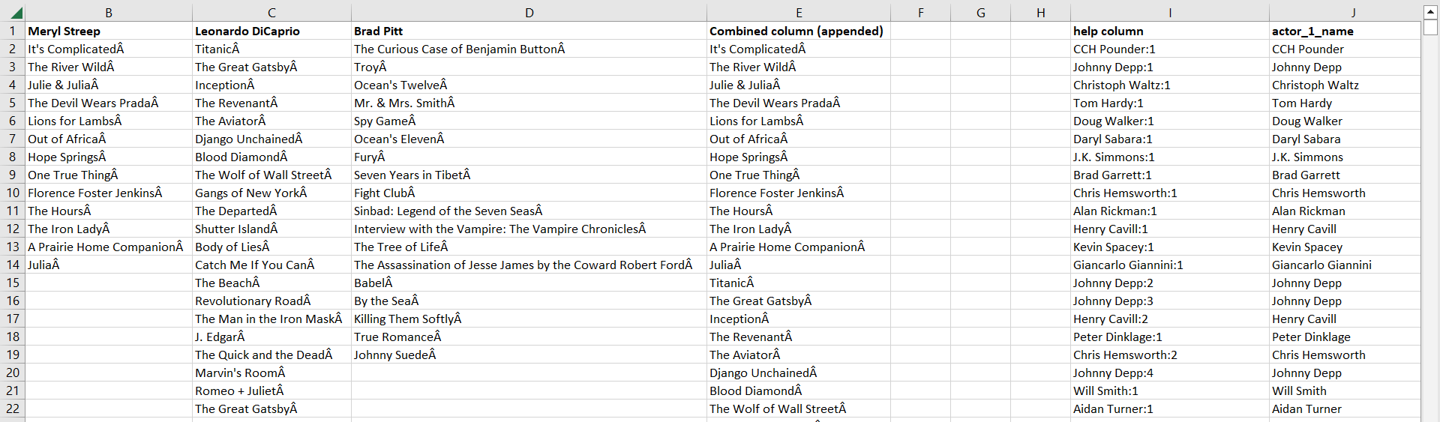
6. Find the critic-favorite and audience-favorite actors
The critic favorite actors are

Slide 8
RESULTS :-
All the results obtained are shown in screenshots in previous slides.
All complete values/data obtained after queries are present in excel attached below .

